Slide 1
SRI ESHWAR COLLEGE OF ENGINEERING
Dept. of Computer Science and Engineering Academic Year: 2019 – 20 (Even Sem)
MINI PROJECT REVIEW
DATE OF REVIEW: 29/02/2020

Slide 2
Batch Members
1. Arun Nataraj S (18CS013)
2. Avinash (18CS017)
3. Devasarathy B (18CS028)
4. Jagathishprabu S (18CS048)
Guide Name : Mr. Sampath Kumar S
Designation : Assistant Professor / CSE

Slide 3
Presentation Outline:
Abstract
Objective
Introduction
Block Diagram
Modules
Requirements
Existing system
Proposed system

Slide 4
Abstract Of the project
Chatbots, or conversational interfaces as they are also known, present a new way for individuals to interact with computer systems.
Traditionally, to get a question answered by a software program involved using a search engine, or filling out a form.
A chatbot allows a user to simply ask questions in the same manner that they would address a human.
Chatbots are currently being adopted at a high rate on computer chat platforms.
The technology at the core of the rise of the chatbot is Natural Language Processing (“NLP”).
Recent advances in machine learning have greatly improved the accuracy and effectiveness of natural language processing, making chatbots a viable option for many organizations.
Keywords: ChatBot, NLP, Machine Learning, Conversational System,

Slide 5
Objectives
The chatbot is socially used and it is a developing technology.
To reduce manpower and provide 24*7 customer care service.
To know the details of our college regarding availability of courses, fees structure, placements, events, etc,. conducted by our college.

Slide 6
Introduction
A chatbot is a piece of technology that allows a computer program to communicate with people just like conversing through text chat and voice chat.
Lakmé is a chatbot which is created by our team to know the details of our college .

Slide 7
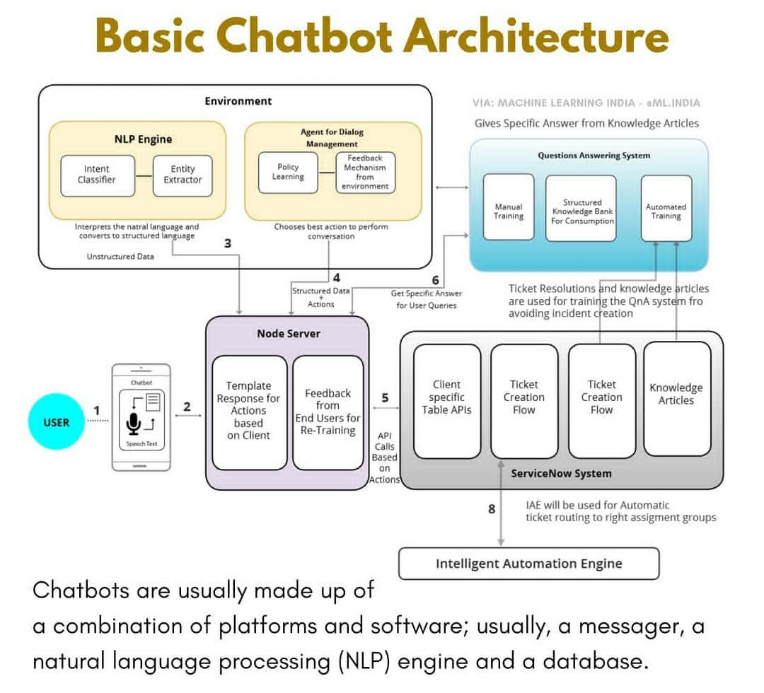
block diagram

Slide 8
Explanation
We have created a chatbot with voice or speech output.
Which answer's the queries about college .
First the bot plays the audio visual about our college and then interaction begins with the user.

Slide 9
Explanation(cont’d)
Where the user can query details of college.
If relevant keyword is present in the query then it displays the answer.
If the keyword is not found then it prints the default statement.
If the user wants to continue then user need to give a query again.
If the user needs to exit they need to give Exit.
At the time of exit the photo of the user will be captured and admission form is filled by the user if they wish.

Slide 10
Modules
Chatbot (Core System)
Video Player
Chatbot Dictionary
Text-to-Speech Converter
Details Collection

Slide 11
Modules Explanation
Chatbot (Core System) Module
Chatbot module is the main module for all the sub-modules in the project.
It works as a chat tool for queries asked by user.
Video Player Module
Video player acts as a primary module in which the video of our college is played when the chatbot is started.
Chatbot Dictionary Module
Dictionary module used to save the keys and values which are used to ask queries and give answers.
Its acts as DataBase.

Slide 12
Module(cont’d)
Text-to-Speech Converter Module
Text to speech module is used to give the output in audio.
Details Collection Module
This module is used to capture the image of the user when they allow it.
Where the user fills the admission form if needed only.

Slide 13
System Requirement
Minimum Hardware Requirements
Webcam
Speaker & Mic
System with 2GB RAM
Software Requirements
Windows 10
Python 3 with pygame, wincom32, CV, random, re, matplotlib packages.

Slide 14
Existing system
Till now we don’t have any chatbot for our college.

Slide 15
Proposed system
Our team is proposed a chatbot called Lakmé for our college.

Slide 16
Queries?
*Suggestions are welcomed.

